Slide 1

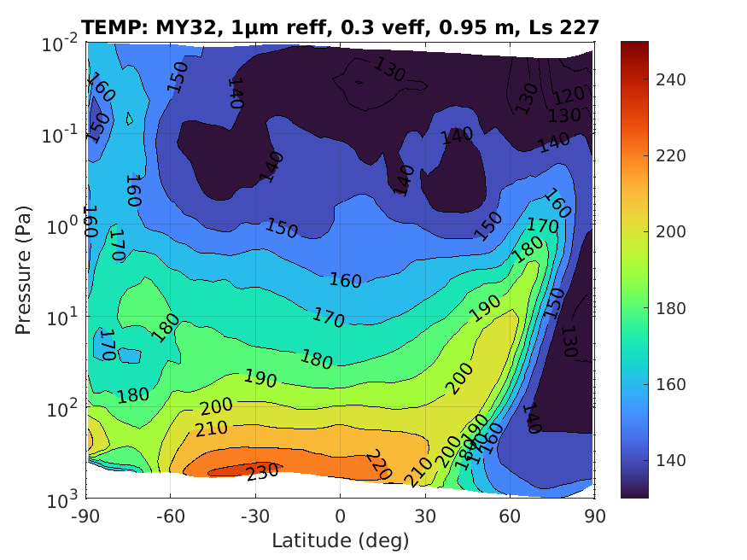
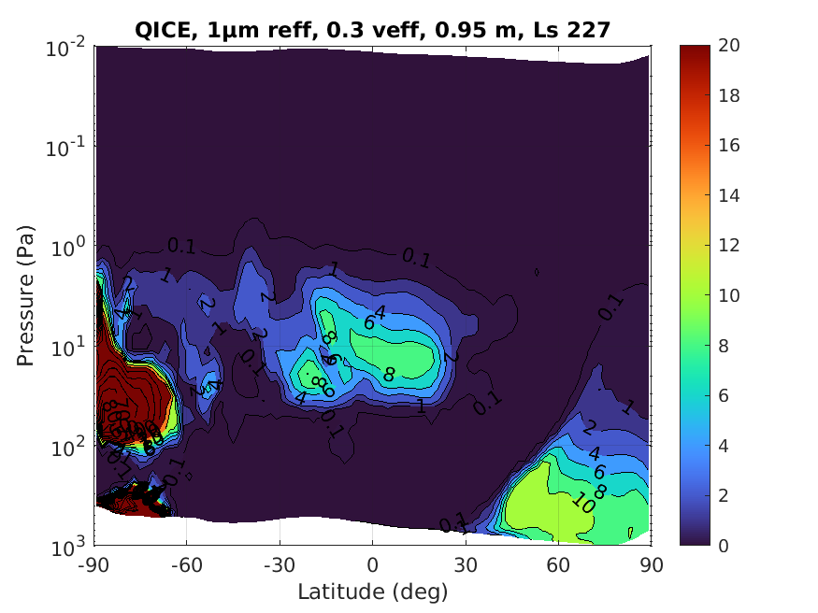
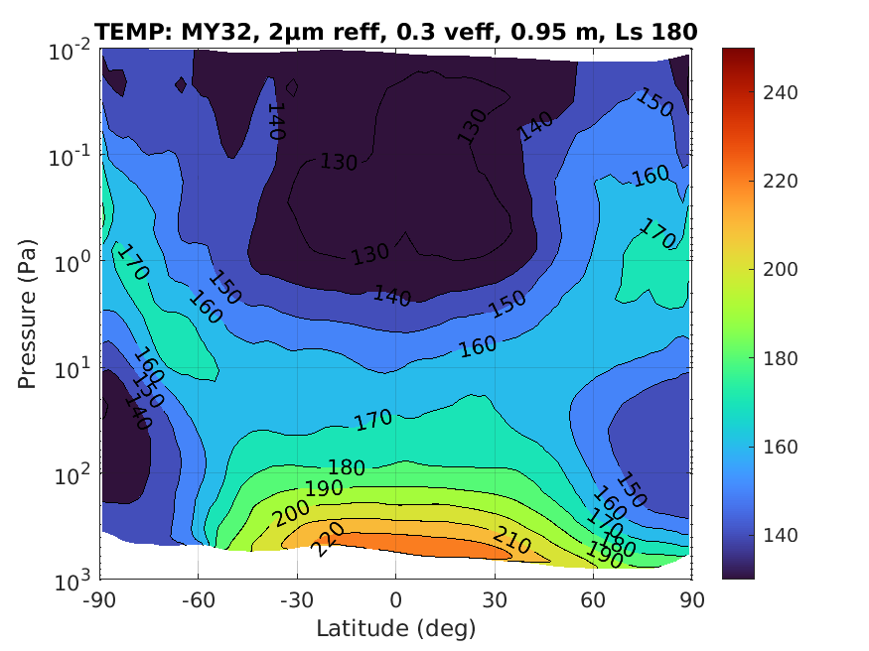
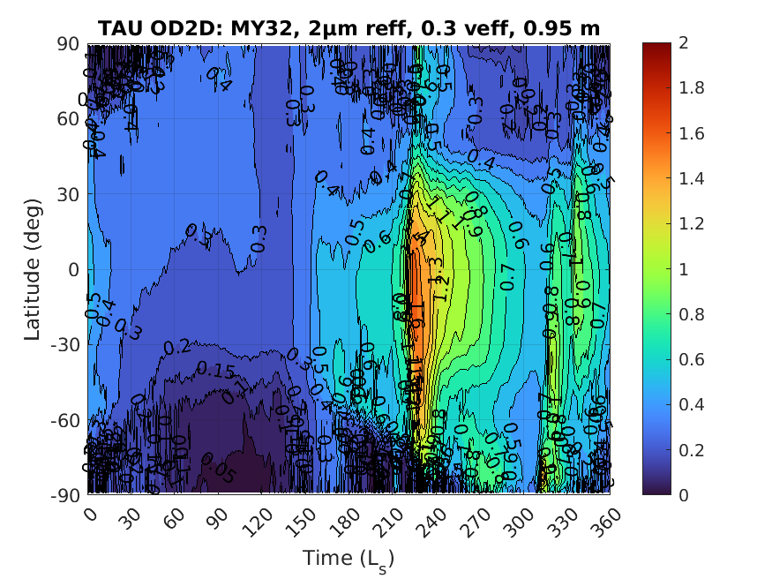
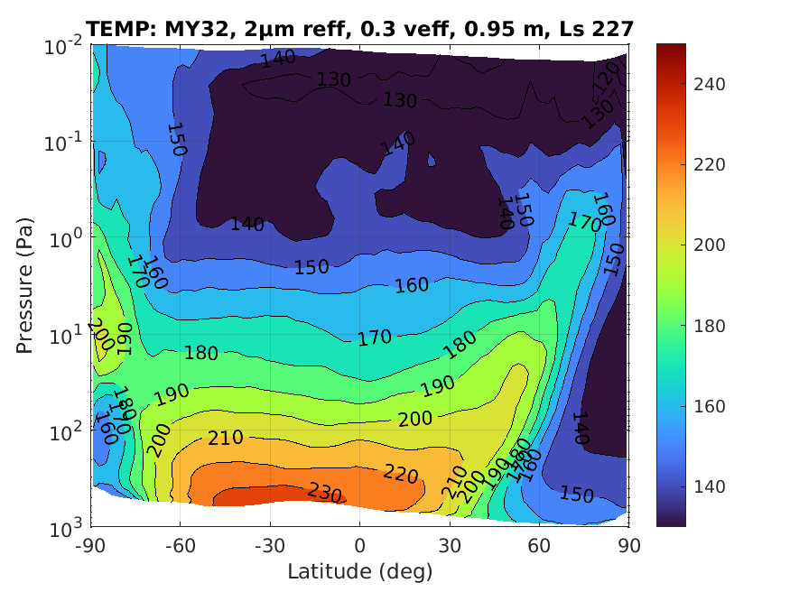
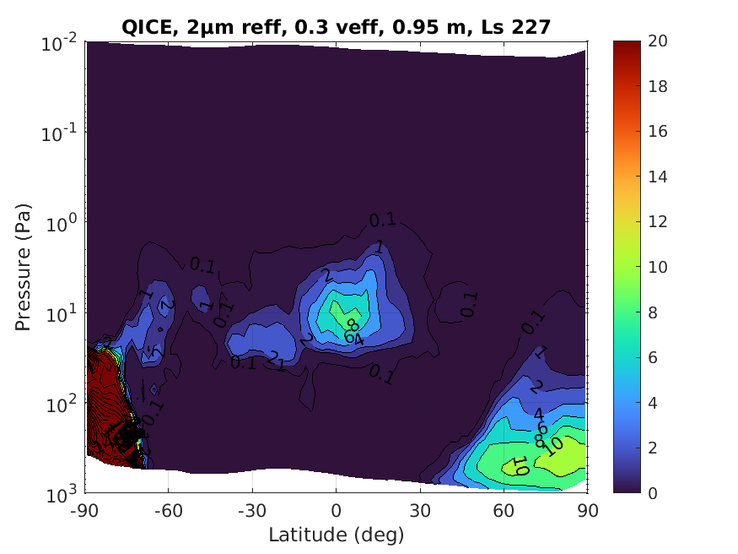
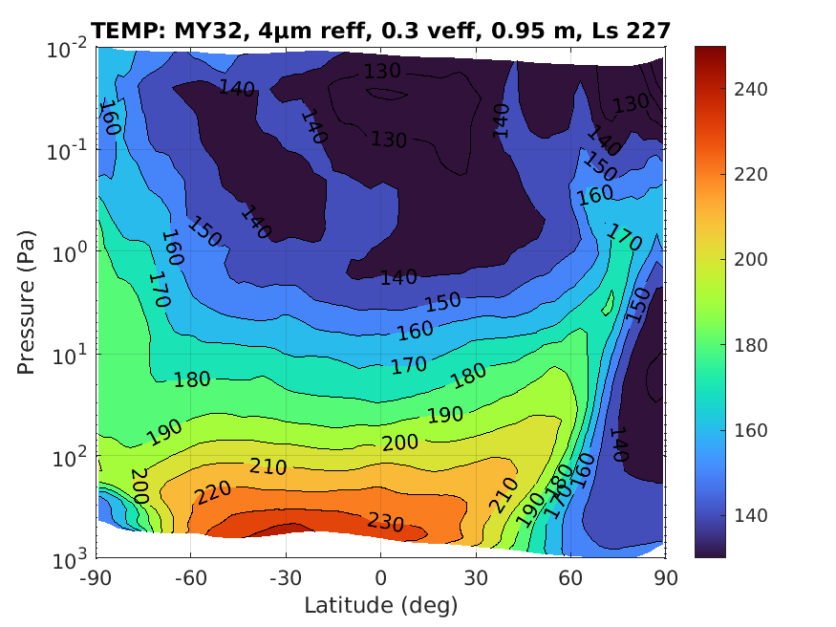
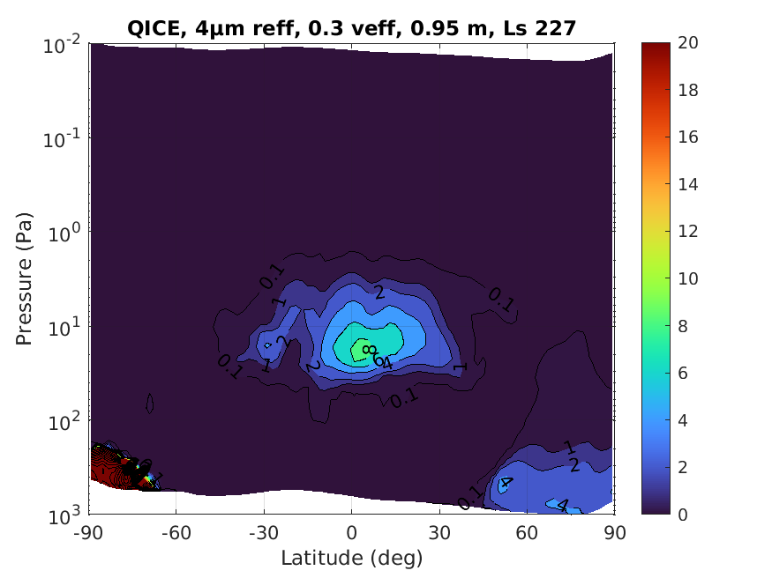
National Aeronautics and Space Administration
Postdoc Research
Radiative Impact and Transport of Martian Aerosols During Regional Dust Storms
Hartzel E. Gillespie (JPL Postdoctoral Fellow, Section 322)
Armin Kleinböhl (JPL/Caltech, Section 322), Chris Lee (University of Toronto), Liam Steele (European Centre for Medium-Range Weather Forecasting)
Background
The dynamics of the Martian atmosphere are strongly influenced by ever-present dust as well as water ice clouds. These aerosols have a strong radiative effect on the atmosphere through both scattering and absorption. The Mars Climate Sounder (MCS) (McCleese et al., 2007), by observing the Martian atmosphere in the infrared, constrains the amount and location of the dust and water ice. However, MCS retrievals assume a distribution of sizes of dust particles, and this particle size distribution is not well constrained. Furthermore, it is known that the dust particle size distribution changes over the course of the year. In particular, during dust storms, it is known that the dust in the atmosphere is, on average, larger than it is during the rest of the year (e.g. Chen-Chen et al., 2021). The amount of influence the particle size distribution has on aerosol transport is not well quantified, and it is not known what changes in atmospheric dynamics and transport pathways for aerosols arise as a result of changes in the aerosol particle size distribution.
Results
Figure 1 shows equinoctial temperatures as well as full year column dust optical depths (“taus”) from the “base run” of MarsWRF, which lifts dust with an effective radius of 2 μm. The “A” regional dust storm (Kass et al., 2016) is readily apparent, and it peaks at Ls 227. The effect of changing the dust effective radius has on the temperature and dust in MarsWRF is shown in Figure 2. As the dust effective radius increases, the strength of the polar warming (the protruding peak in temperature from 50 N, 100 Pa up to 80 N, 0.5 Pa) weakens, which is indicative of a weakening in the meridional circulation. Such a weakened meridional circulation would supply less water to the atmosphere, which is likely the reason for the reduction in ice in the northern polar region with increasing dust effective radius, and perhaps also the reason for the different extents of the equatorial ice cloud among the runs. The morphology of the north polar clouds also differs: with 1 μm dust, the north polar clouds are somewhat annular, while at other sizes, the north polar clouds are not annular.
Objective
Determine how changes in the dust particle sizes being lifted from the Martian surface affect the amount and transport of aerosols within the Martian atmosphere.
Figure 1: Zonal mean temperature cross-section and column dust optical depth timeseries for the “base run” of MarsWRF at the autumnal equinox (Ls 180): dust is lifted with an effective radius of 2 μm and variance of 0.3.
Approach
We simulate the Martian atmosphere using the Mars Weather Research and Forecasting (MarsWRF) global climate model (GCM) (Richardson et al., 2007; Lee et al., 2018). MarsWRF provides information about temperatures, winds, aerosol quantities, and the dust particle size distribution everywhere in the simulated Martian atmosphere. To make our MarsWRF run more closely resemble reality, we force dust to be lifted from the surface if more dust is present in MCS observations than there is in the MarsWRF simulation (Montabone et al., 2015). Using MarsWRF, we vary the particle size of the dust lifted from the surface of Mars.
Future Work
Runs will be performed for another Mars year to quantify interannual variability, and the rate of formation of ice particles will be varied. We will also analyze the meridional transport of dust and water in MarsWRF by decomposing the transport into mean, stationary, and transient components. This work in progress will be presented at the AGU Fall Meeting in New Orleans, LA in December, and a paper summarizing the work will be submitted in the spring to Icarus or JGR-Planets.
Figure 2: Zonal mean temperature cross-section and ice mass mixing ratio (ppm) cross sections at the peak of the Mars Year 32 “A” regional dust storm. The rows show results with different lifted dust effective radii: top row 1 μm, middle row 2 μm, and bottom row 4 μm.
Significance of Results/Benefits to NASA/JPL
Quantifying the radiative effects of aerosols may accomplish the following:
Improved knowledge of atmospheric dynamics and aerosol transport
More precise entry and descent to Mars
Tighter constraints on energy usage and solar energy generation
National Aeronautics and Space Administration
Jet Propulsion Laboratory
California Institute of Technology
Pasadena, California
www.nasa.gov
Publications and Acknowledgements:
H. E. Gillespie, A. Kleinböhl, C. Lee, and L. J. Steele (2024), Investigation of the Radiative Impact and Transport of Martian Aerosols Using MarsWRF, Tenth International Conference on Mars, Pasadena, CA and AGU Fall Meeting, Washington, DC
Author Contact Information:
818-354-2970, hartzel.e.gillespie@jpl.nasa.gov
Clearance Number: CL#00-0000
Poster Number: Postdoc-P-003
Copyright 2025. All rights reserved.

